Slide 1
mTSP/VRP in Accreditation
Saul Alarcon

Slide 2
Introduction
TSP is the Traveling Salesmen Problem
Aims to find the shortest tour or the tour with minimum cost for the given number of points, i.e., cities, pieces, vertices, etc., where all the distances between the points are known.
mTSP is the Multiple Traveling Salesmen Problem
Aims to acquire the minimum cost for traveling a given set of cities by assigning each of them to a different salesman in order to create m number of tours.
Just like the TSP, but with more salesmen
VRP is the Vehicle Routing Problem
Generalization of the mTSP, similar structures/algorithms

Slide 3
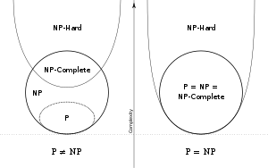
NP-hard Class
mTSP is an NP-hard problem in combinatorial optimization.

Slide 4
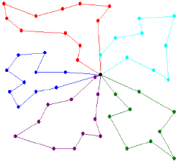
mTSP Example

Slide 5
Why Study mTSP/VPR ?
Important topic in operational management
Applications:
Electrical Circuit Boards
Robot Control
Ant Colonization (Yes, Really!)
Accreditation Tours

Slide 6
Problem Background
Inspectors are distributed from the Accreditation organization to multiple facilities.
A client is requesting a large number of facilities to become accredited within a short time frame.
Some locations generate more revenue for the client, and therefore are prioritized in the tour.
With three inspectors, what is the optimal route for each one?

Slide 7
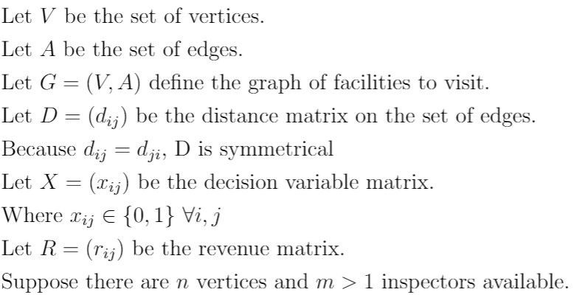
Definitions

Slide 8

Objective

Slide 9
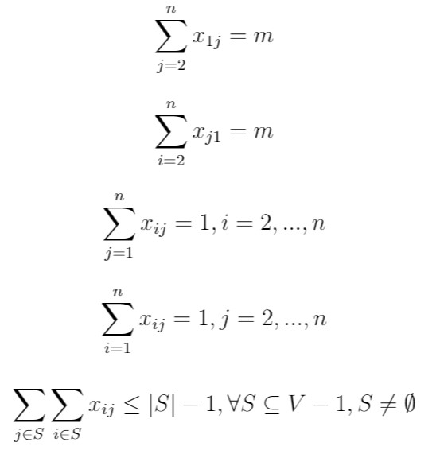
Constraints
m Inspectors begin at the same location
m Inspectors end at the same location
Each facility must have one inspector visiting
Each facility must have one inspector leaving
No sub-tours

Slide 10
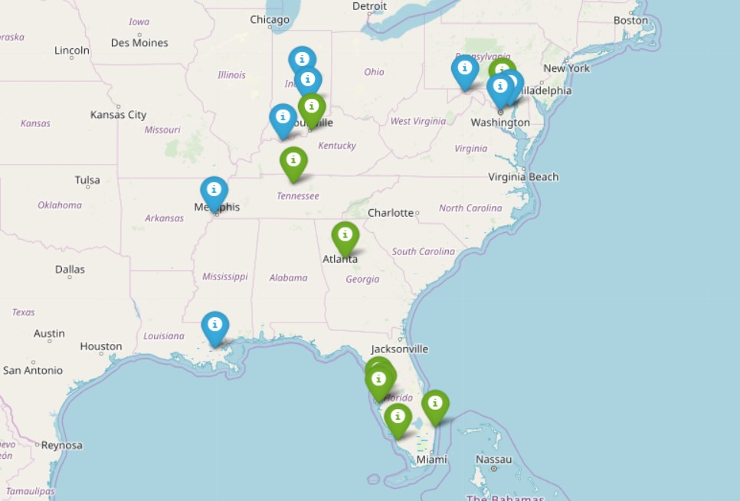
Locations

Slide 11

Results
Tour 1:
1-11-8-1
Tour 2:
1-9-2-1
Tour 3:
1-5-4-17-3-10-6-7-13-14-12-15-16-1
Runtime: .12 CPU seconds

Slide 12
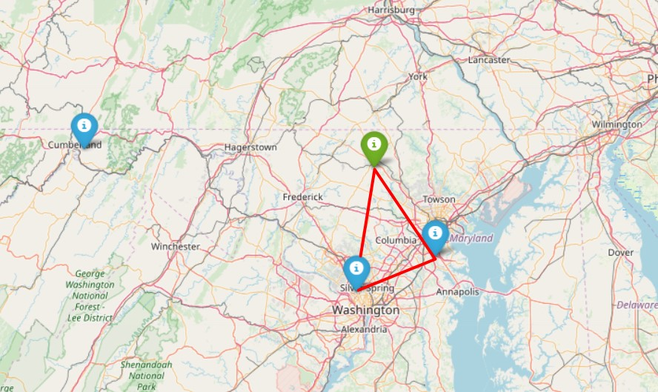
Results – Route 1

Slide 13
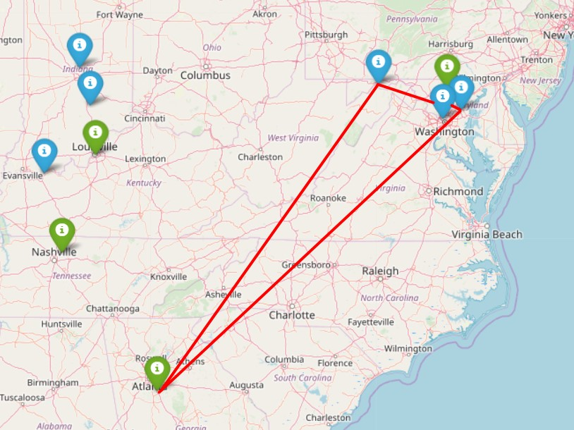
Results – Route 2

Slide 14
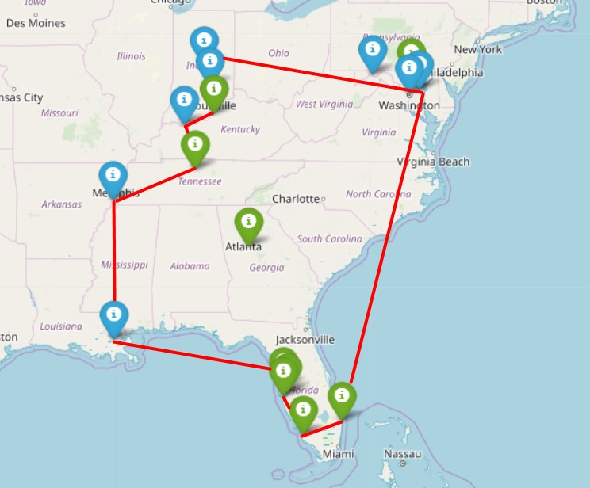
Results – Route 3

Slide 15
Challenges
Subtour constraints became too difficult to handle manually.
Over 50 subtour constraints created.
No benchmark for optimization time.
Did not create custom optimization tool.
Little to no control of model selection.

Slide 16
Future Work
Occasional Drivers (Archetti et al., 2016)
Allows for drivers willing to make a single delivery from their own destination
Vehicle Routing Problem with carbon emission (Zhang et al., 2015)
Considers fuel consumption and carbon emission when weighing distances.
Consider alternative optimization models (Nuriyeva, Kizilates, 2017)
B&B Algorithm
Shortest Path Algorithm
Insertion Heuristic
Multiple Depots
Constant Visited Vertices
Credentials

Slide 17
References
Archetti, C., Savelsbergh, M., Speranza, M. G. (2016). The Vehicle Routing Problem with Occasional Drivers. European Journal of Operational Research, 254(2), 472480. doi:10.1016/j.ejor.2016.03.049Liu, B. (2009).
Theory and Practice of Uncertain Programming. Berlin, Heidelberg: Springer Berlin Heidelberg.Nuriyeva, F., Kizilates, G. (2017).
A NEW HEURISTIC ALGORITHM FOR MULTIPLE TRAVELING SALESMAN PROBLEM. Journal of Applied and Engineering Mathematics, 7, 101109.Zhang, J., Zhao,Y., Xue,W., Li, J. (2015).
Vehicle routing problem with fuel consumption and carbon emission. Int. J. Production Economics, 232242.

